Slide 1

Department of Computer Engineering
Card Game
Mini Project Presentation
Kunjan Kanani – 92100103216 – TC-3 Batch A
Jimish Khokhar – 92100103228 – TC-3 Batch A
Darshan Rathod – 92100103226 - TC-3 Batch A

Slide 2
Abstract
Introduction to Project
Tools and Technologies
Existing System
Proposed System
Screenshots
Conclusion
Contents

Slide 3
There were very few card game applications or applets written in Java.
So, We made a game of card to play with your friend ,win this game and enjoy that great moment.
In this game connect with host in same stream and play this game.
Abstract

Slide 4
In the game two player can play to build connection using Java Socket programming.
The Card class is a very simple one: it contains values signalling the color and the value. It may also have images and similar entities that describe the card, when start game shuffle the card and distribute it to player and host.
According that card player can do bit on it, increase bit, do claim to show cards or pack own game.
All this things visual better we use Graphical User Interface (GUI).
Introduction to Project

Slide 5
Java AWT (Abstract Window Toolkit)
GUI (Graphical User Interface)
Tools and Technologies

Slide 6
Multi threading
Swings
Java Collection
Event Handling
Core Java Concepts used in Project

Slide 7
There are many card game apps, but some of not friendly to play using lan connection.
Existing System

Slide 8
List
Very easy to play
Can play on lan network
Avoid data manipulations.
Proposed System

Slide 9
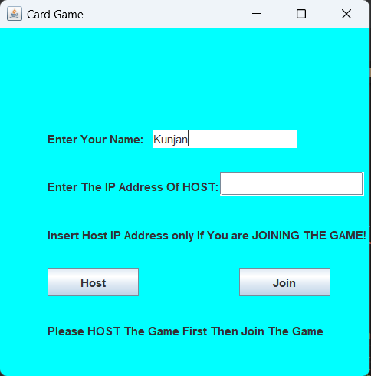
Host Hosting the game:
Screenshots

Slide 10
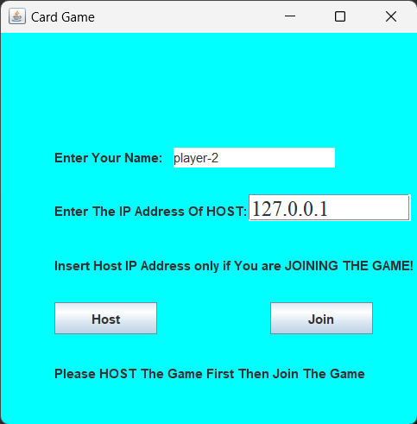
Player-2 Joining:
Screenshots

Slide 11
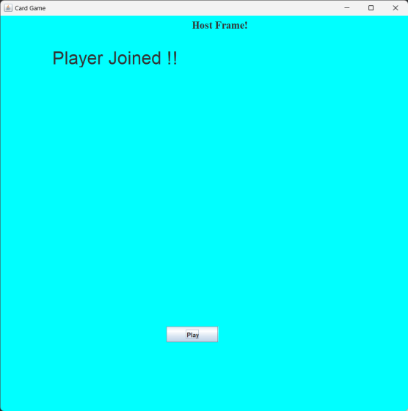
Player-2 Joined:
Screenshots

Slide 12
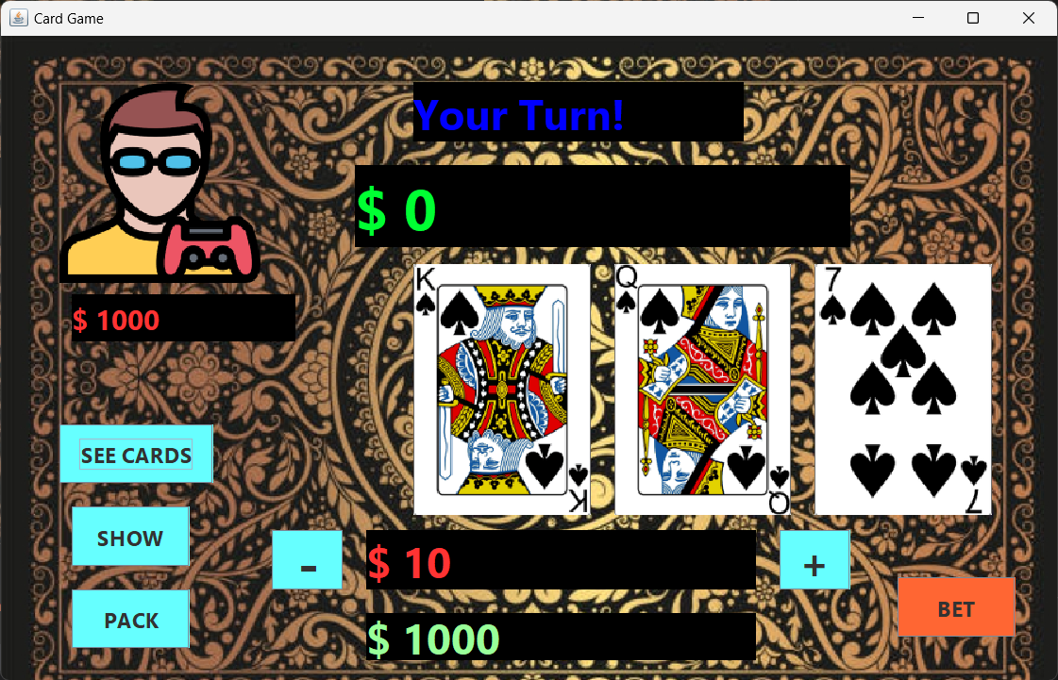
Host’s TURN :
Screenshots

Slide 13
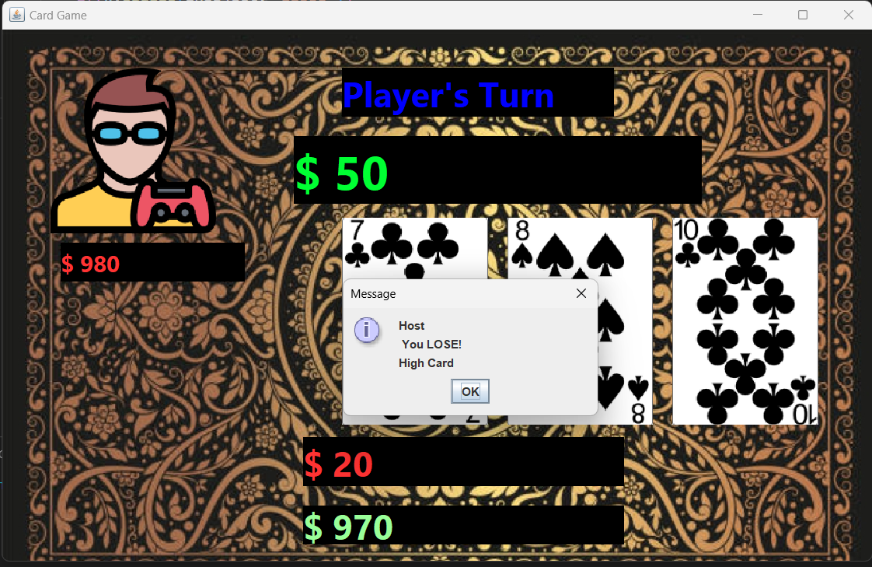
Host’s SHOW :
Screenshots

Slide 14
The process continues, now there is a fairly stable framework to use for creating card game. We describe how this framework was designed, how it operates, and the tools and tricks that were used to make it useful and stable.
Conclusion

Slide 15
IEEE Format
https://google.com
https://www.geeksforgeeks.org
https://javatutorials.com/employee-management-system-project-in-java
https://github.com/topics/employee-management-system?l=c%2B%2B
5. https://www.youtube.com/watch?v=E1ehMzKLKXk&ab_channel=NGTutorials
References

